Slide 1
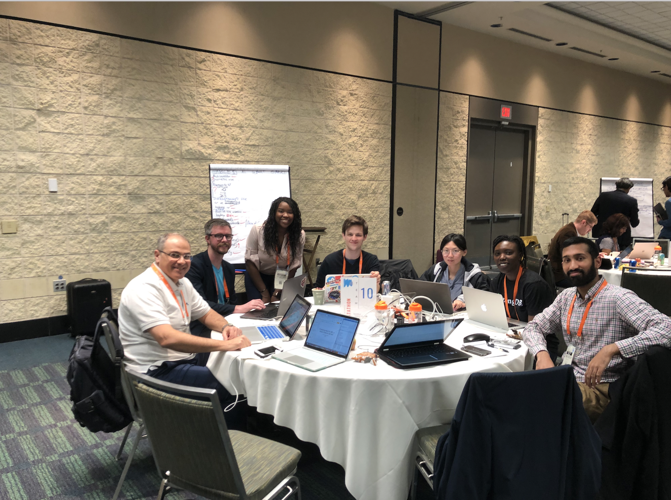
Predicting Need for RRT in Septic Patients with AKI
RRT-Sepsis 3PO
Adel, Andre, Rene, Mat, Mallory, Evon, Hannah, Travis

Slide 2
Research Question:
At 24 hours after ICU admission, can we predict which septic patient will require RRT?
Notes:
Among patients with sepsis who were not on dialysis prior to ICU admission, can we predict the need for renal replacement therapy at 24 hours after ICU admission? And at time of onset of acute kidney injury?

Slide 3
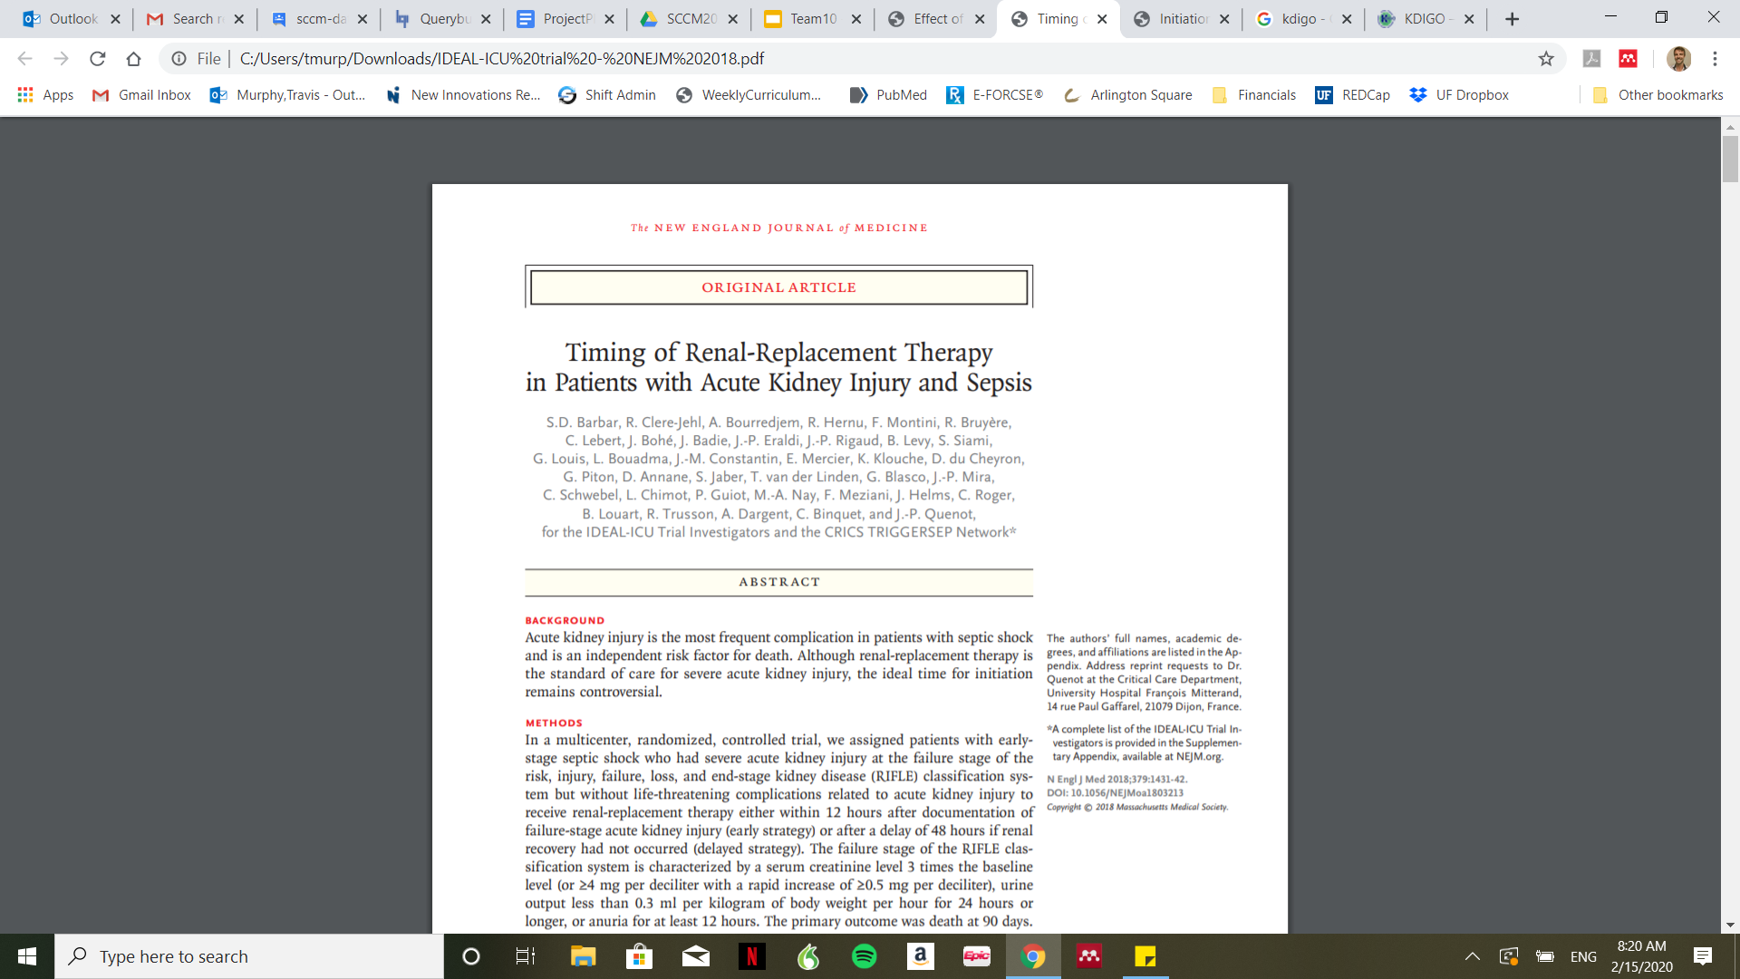
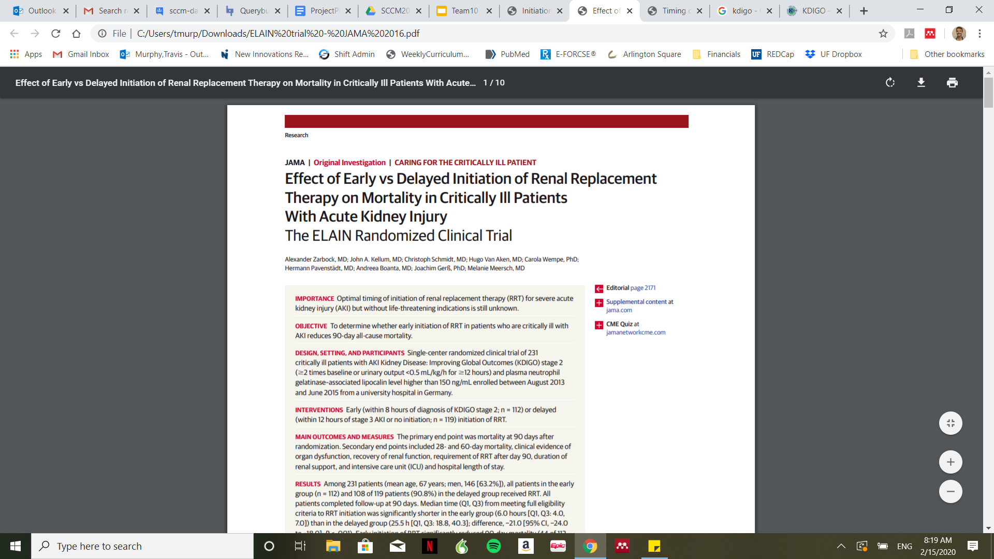
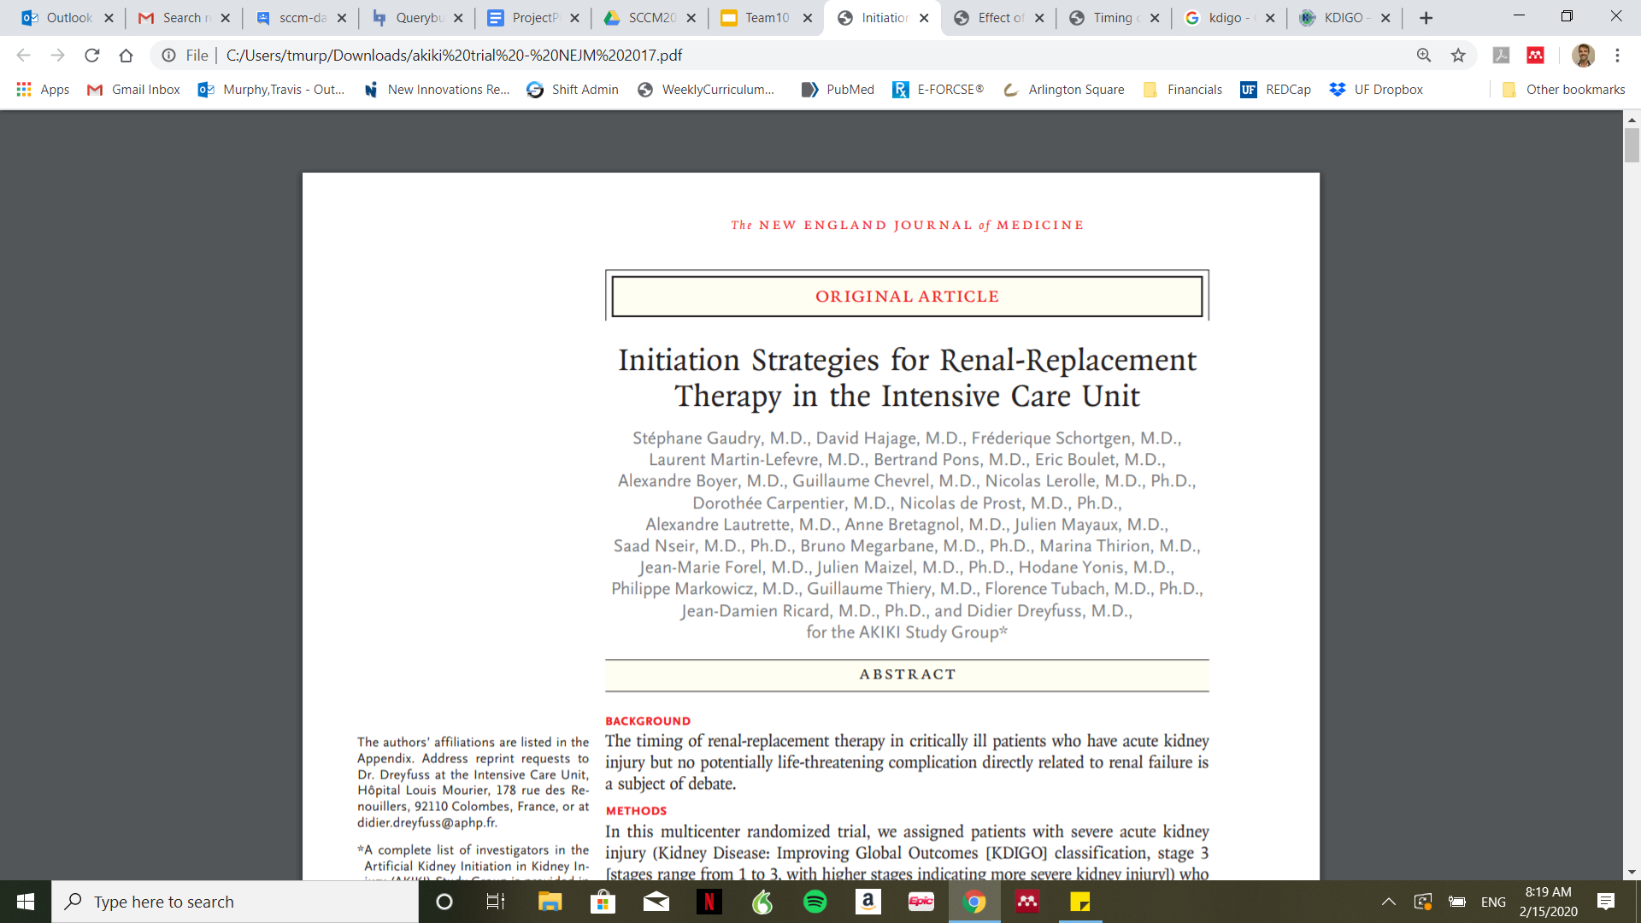
Background
AKIKI: Gaudry et al. NEJM 2016 Jul 14;375(2):122-33, ELAIN: Zarbock A et al. JAMA 2-16 May 24-31;315(20):2190-9, IDEAL-ICU: Barbar et al. NEJM 2018;379(15):1431-42

Slide 4
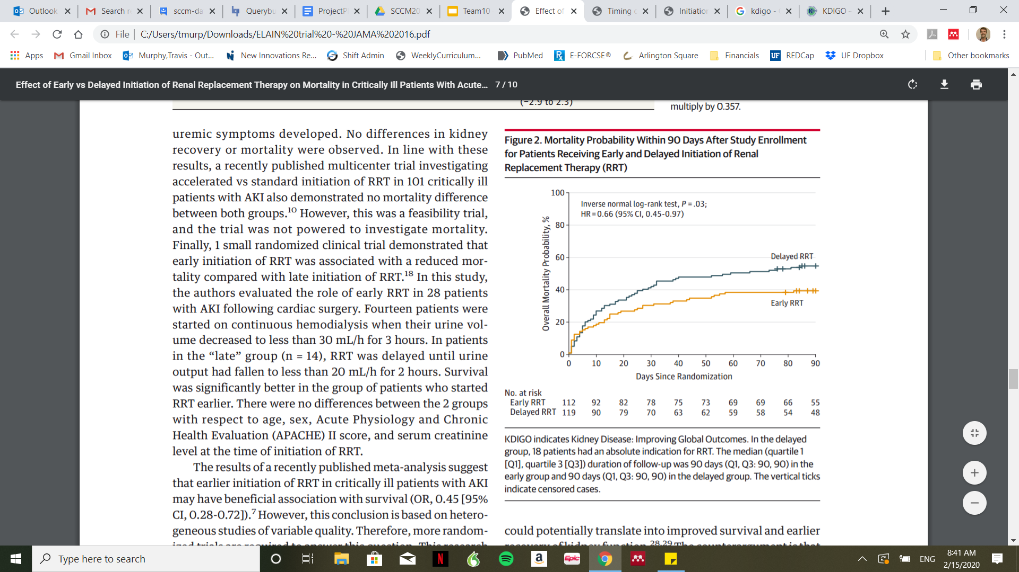
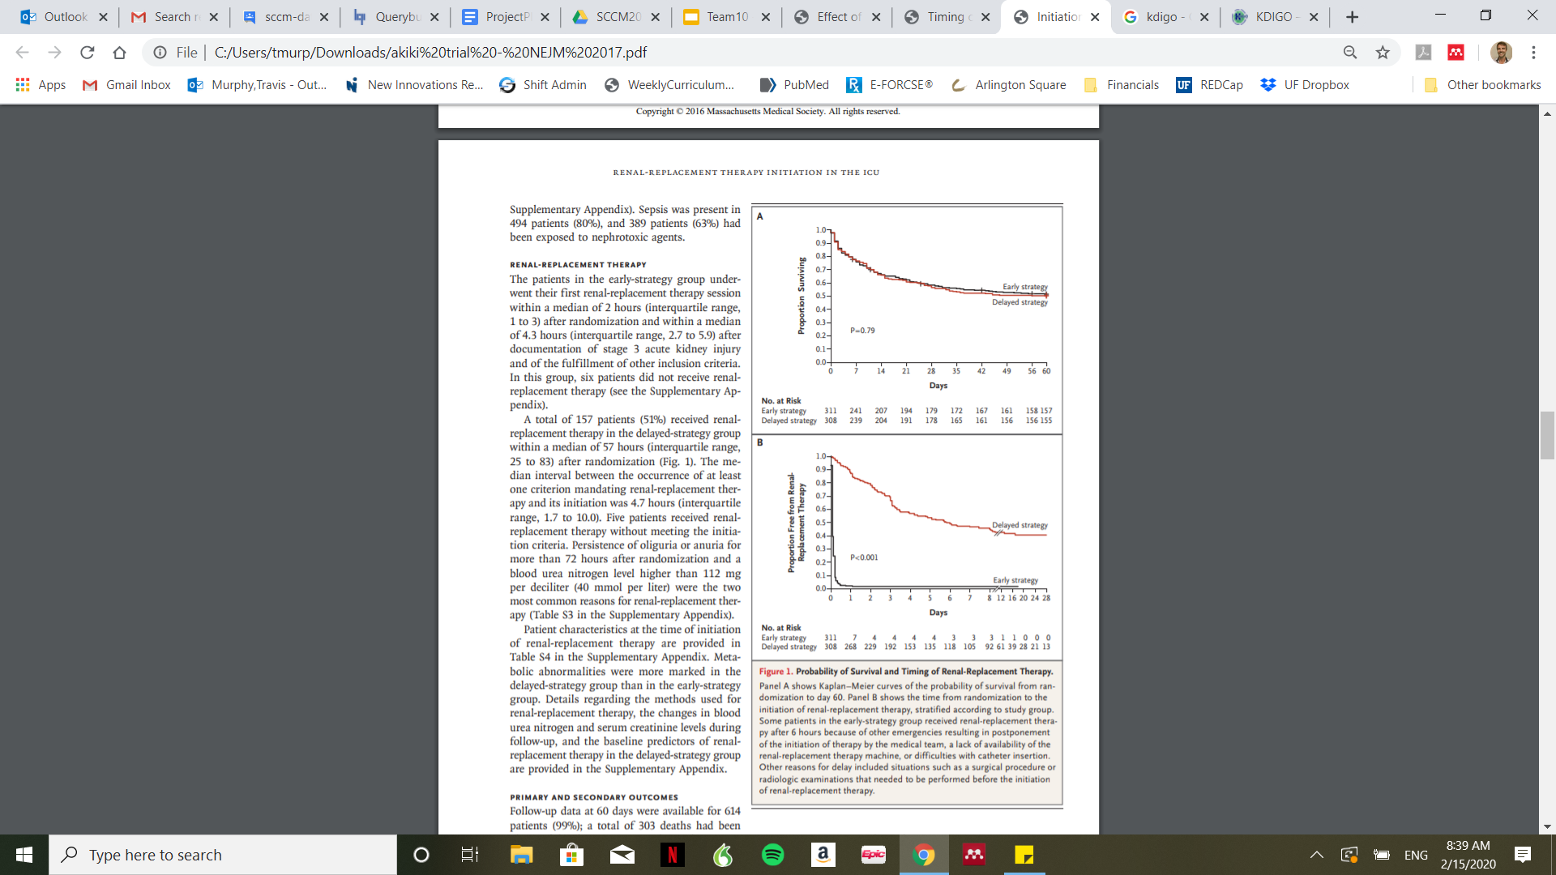
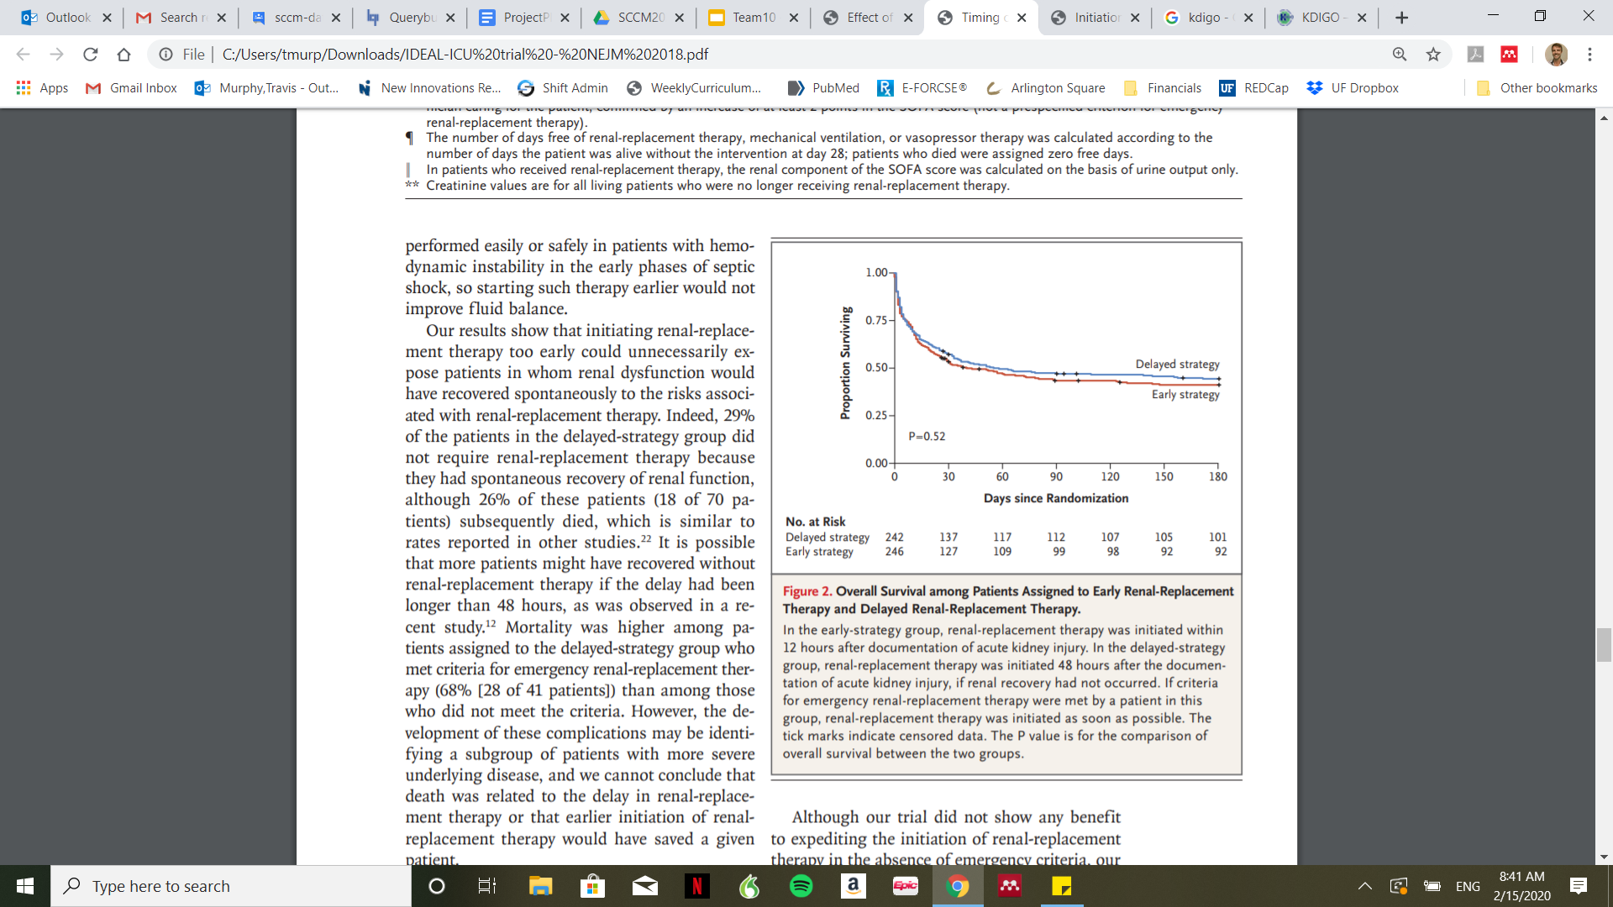
Background
AKIKI: Gaudry et al. NEJM 2016 Jul 14;375(2):122-33, ELAIN: Zarbock A et al. JAMA 2-16 May 24-31;315(20):2190-9, IDEAL-ICU: Barbar et al. NEJM 2018;379(15):1431-42

Slide 5
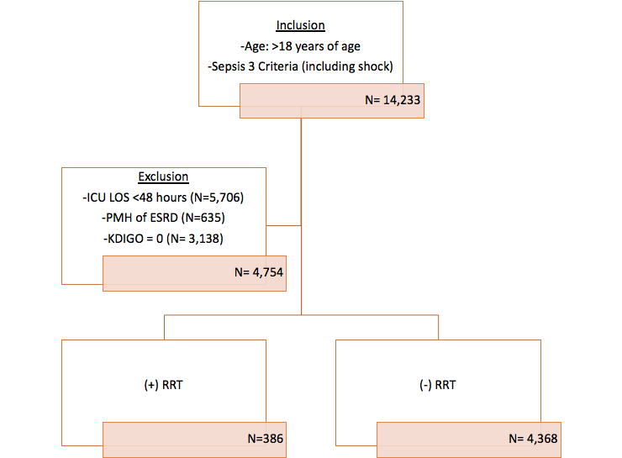
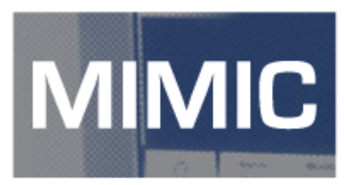
Cohort Discovery:
MIMIC-III V. 1.4
(Medical Information Mart for Intensive Care III)

Slide 6
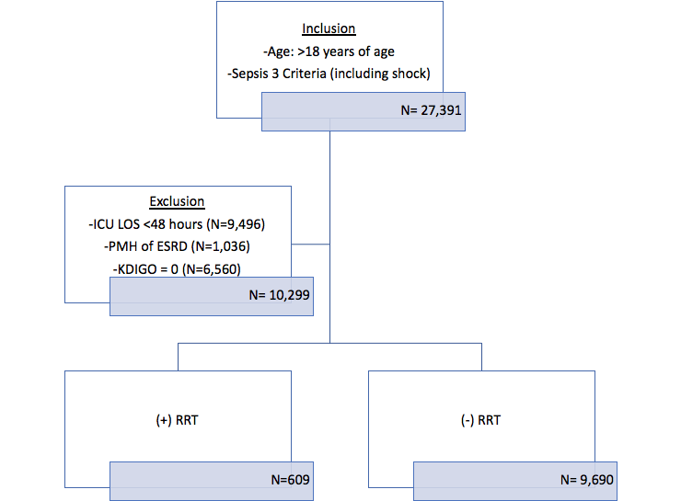
Cohort Discovery
MetaVision System (2008-2012)
MIMIC system (2001-2008)
Notes:
Need numbers once cohort is discovered; RRT vs. CRRT cohort 2008-2012 to 2001-2008

Slide 7
Data Analysis Process
Build cohort
Validate and Clean data
Develop Model and Assess
Clinical Tables
Admissions
Patients
ICU stays
Diagnosis ICD
Examine outliers and implement sanity checks (e.g. lab values and vitals)
80% train / 20% test
Derived Tables
Oasis
Sofa
Saps ii
Sepsis 3
Elixhauser quan
Vaso durations
heightweight and weight durations
Labs and blood gas first day
KDIGO stages
Vent durations
RRT pivoted
CCRT durations
Logistic Regression with L1 regularization (inverse probability weighting)
Impute missing data values with measures of central tendency (mean)
XGBoost (4-fold)

Slide 8
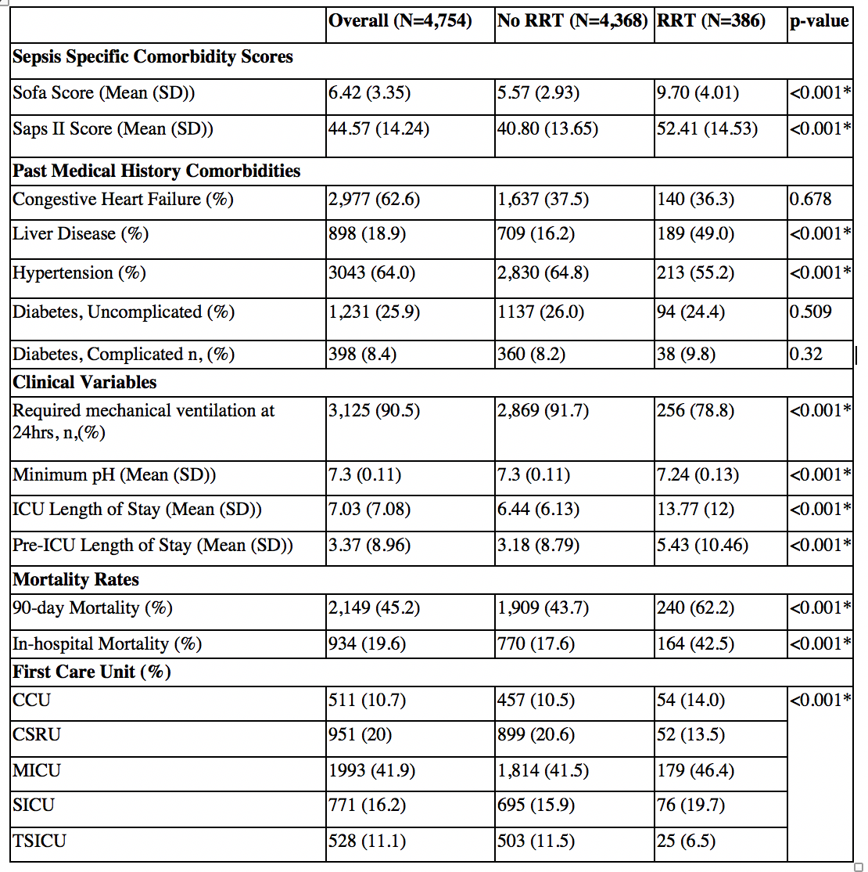
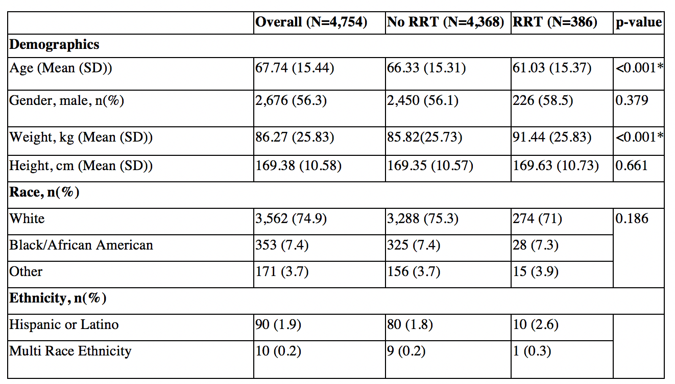
Results: Table 1
Paired t-tests
Notes:
T-tests for compariosn, p-value evaluated <0.05

Slide 9
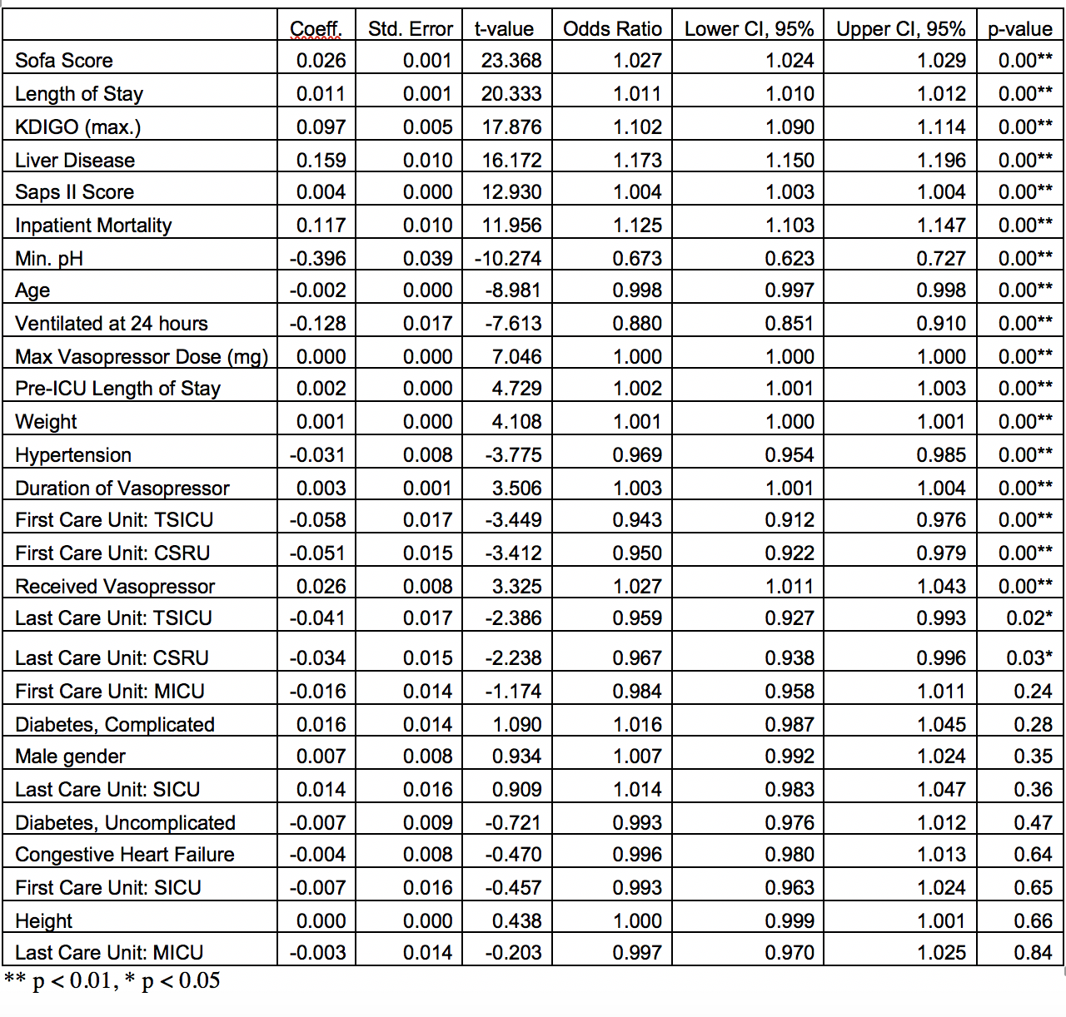
Results:
Odds Ratios

Slide 10
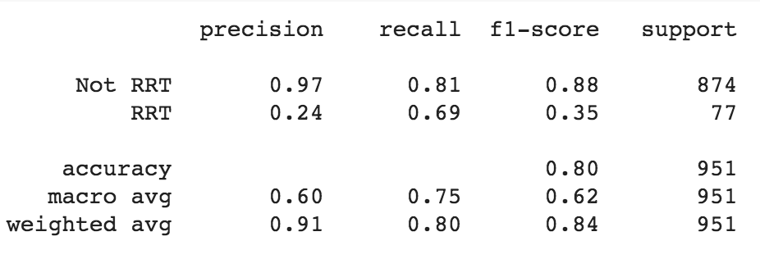
20% Test Set Performance

Slide 11
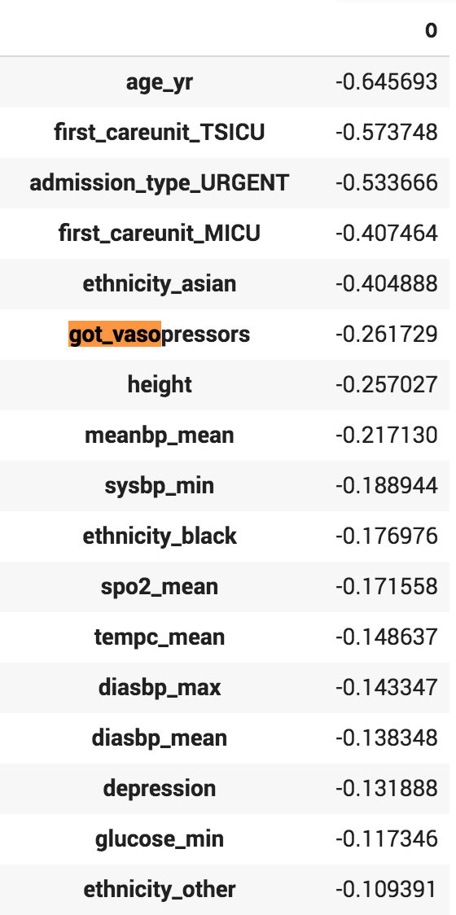
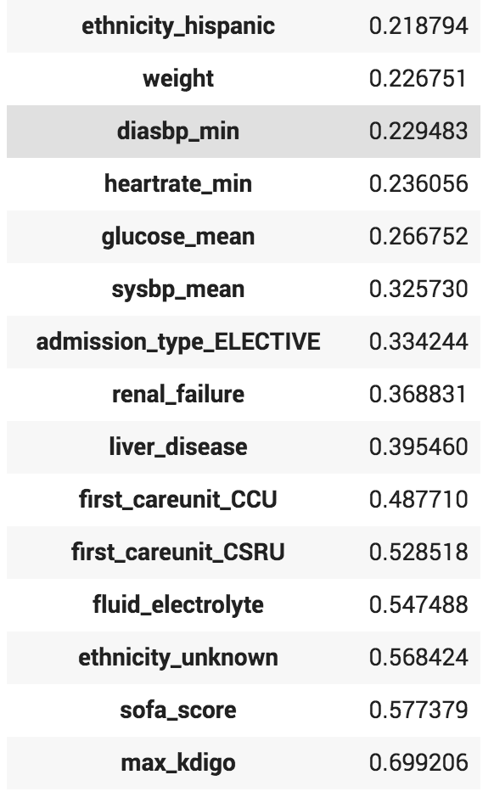
Feature Ranking

Slide 12
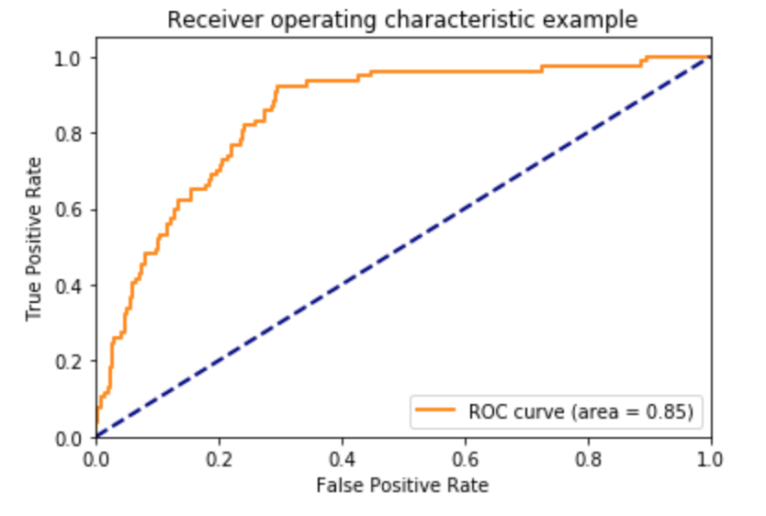
Model Performance

Slide 13
Conclusions
Model identified clinically relevant variable of high predictability of RTT
Predicting need for RRT within first 24 hours of ICU stay is a noble aim.
The limited signal from the RRT case created a difficult challenge for prediction. As cohort size increases, model prediction expected to improve.

Slide 14
Limitations
Data from 2008-2012.
ESRD ICD-9 code for ESRD (available in 2005), earlier data excluded.
Difficult to obtain relevant data:
Hospital ward details prior to ICU admission
Fluid balance
IV Contrast Dose

Slide 15
Next steps
External validation on different cohort
Updating the model utilizing data from MIMIC-IV (August 2020)
Evaluation of influence of timing on outcome

